Slide 1
I210 Information Infrastructure
Lab 5

Slide 2
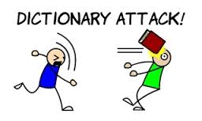
Topic
Today’s focus is dictionaries.

Slide 3
Quick Review - Dictionaries
Dictionaries use this format:
# notice the { } here!
indiana_terms = { "IU": "Indiana's flagship university",
"Purdue": "Clearly not as good, right?",
"cardinal": "Official state bird of Indiana",
"hoosier": "Name for someone living in Indiana” }
print( indiana_terms["cardinal"] )
>>>
Official state bird of Indiana

Slide 4
When to Use a Dictionary?
When is a good time to use a dictionary?
Do you need to count how many times something occurs?
Do you need to keep track of unique information?
Do you need to associate a small piece of data (like a state abbreviation) with a larger piece of data?
→ (AIs / UIs share opinions on this)

Slide 5
Dictionary Stack (Group Work)
In each of these situations, identify what would be the keys and what would be the values:
You want to have some way to look up the value of each of the standard US coins, by name. (quarter, dime, etc…)
You want to load a file containing a book, and figure out how many times each word is used.
You want to allow a user to create an alias or nickname for entries in their contacts list, which are full names.

Slide 6
Dictionary Stack (Solution)
You want to have some way to look up the value of each of the standard US coins, by name. (quarter, dime, etc)
Keys: names of coin (string)
Values: amounts of coin (int)
You want to load a file containing a book, and figure out how many times each word is used.
Keys: words (string)
Values: counts (int)
You want to allow a user to create an alias or nickname for entries in their contacts list, which are full names.
Keys: nicknames (string)
Values: full names (int)

Slide 7
Quick Review – Dictionaries and in
grades = {"Sam": 90, "Ali": 92, "Dave": 85, "Pat": 81}
person = input("Whose grade do you want to know? ")
# you can use membership to check if item in dictionary
if person in grades:
print(person, "got a", grades[person])
else:
print("They got a 0 for not turning in their work.")

Slide 8
Quick Review - Dictionaries
Adding an entry:
grades["Jim"] = 97
Changing the value of an entry:
grades["Pat"] = 88
Deleting an entry:
del grades["Sam"]

Slide 9
Quick Review - .get()
The .get() method allows us to return the value at an index, or an alternate message if that index doesn’t exist. Anyone without a grade got a 0, right?
person = "Sam"
print(person, "got a", grades.get(person, "0"))
>>> "Sam got a 90"
person = "Alan"
print(person, "got a", grades.get(person, "0"))
>>> "Alan got a 0"
→ We can assign the result of .get() to a variable or use it directly!

Slide 10
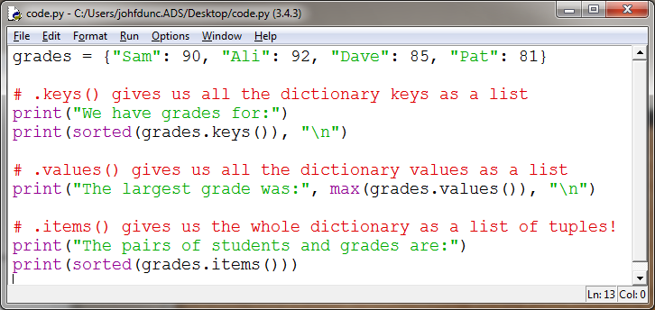
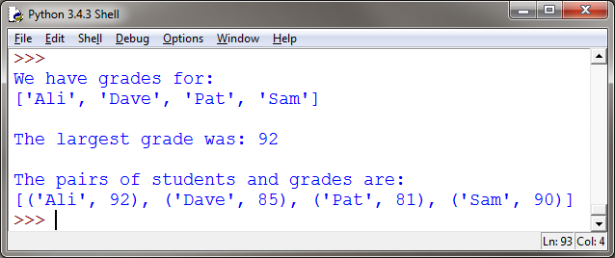
Quick Review – Dictionary Methods

Slide 11
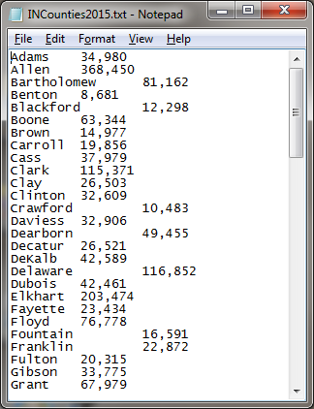
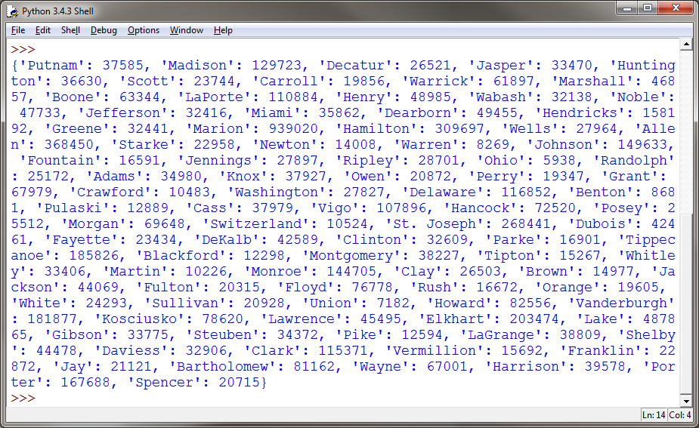
IN Counties pt 1 (Group Work)
Download INCounties2015.txt – this file contains statistical data about the population of Indiana’s counties in 2015.
Write a program that can load this data into a dictionary.

Slide 12
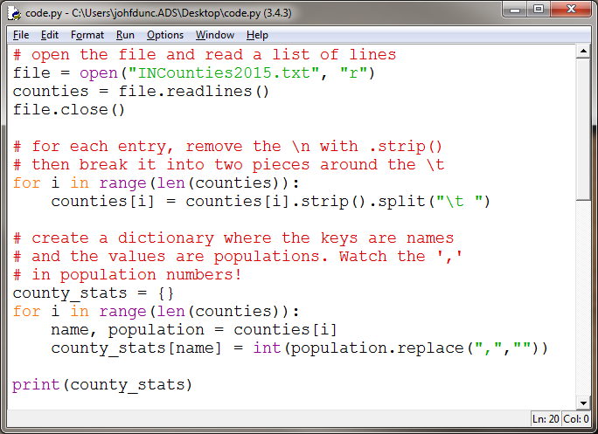
IN Counties pt 1 (Solution 1)

Slide 13
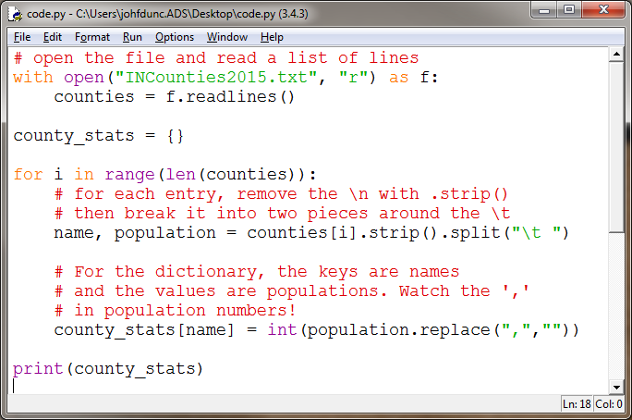
IN Counties pt 1 (Solution 2)

Slide 14
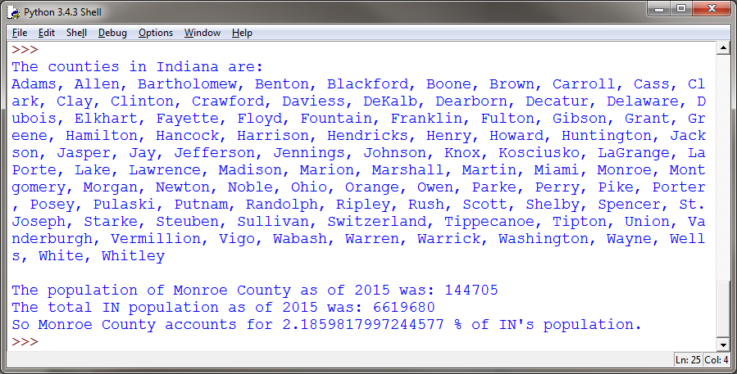
IN Counties pt 2 (Group Work)
Now, use your dictionary to output this information:

Slide 15
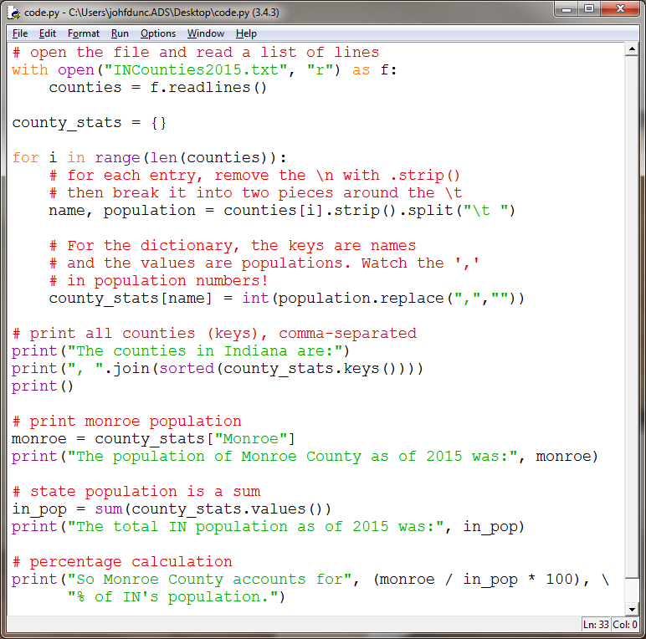
IN Counties pt 2 (Solution)

Slide 16
Questions?

